Slide 1
Health Information System
Developed a basic health information system for managing clients and health programs

Slide 2
Outline
Technical Approach
Tools
Features
Security Considerations
Future Developments

Slide 3
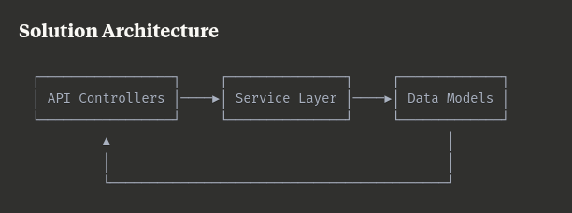
Technical Approach
Designed RESTful endpoints
Created clear models for Clients, Programs, and Enrollments
Implemented basic authentication and data validation.
Designed a user interface with web technologies

Slide 4
Tools Used
Meta Framework
Nuxtjs: Manages both backend and frontend development in one application
Data Storage
Use postgres to store the apps data

Slide 5
Features
User management
User Registration
Logging in
Logout
Programs
Program registration
Clients
Registered
Setup for login
Public client profile
Enrollments
Clients enrolled in one or more programs
Client view notes made by doctors
Doctors manage the CRUD with ‘doctor’ role.
1

Slide 6
Security Considerations
Input validation to prevent injection attacks
Authentication for API access
Data encryption for sensitive information
Expiring login sessions

Slide 7
Future Developments
Upgrade the model definitions into a robust collection to better handle all health information management sectors.
Setup more efficient authentication and authorization system and give more fine grained controls of different system features.
Features left for future upgrades

Slide 8
Thank You
Obuya Erick

